Slide 1
RESULT ANALYSIS
PRESENTED BY:-
ARINDAM GHOSH (12)
NINAD PATIL (33)
SARATH SHANKARANARAYANAN (41)

Slide 2
CONTENTS
INTRODUCTION
SYSTEM STUDY
ANALYSIS & DESIGN
TESTING AND VALIDATION
USER MANUAL
CONCLUSION
REFERENCES

Slide 3
INTRODUCTION
ABSTRACT:
Result Analysis is an application which works as a convertor, converting University MCA results into Excel Spreadsheet and stores the data in the database and also search a particular given result of the student from the database.
Earlier user manually entered data into excel sheet and store the records in a different file. This application eliminates the manual work and makes it easy for the user to handle records.

Slide 4
INTRODUCTION
PROBLEM DEFINITION:
Difficult to convert data of pdf file to excel sheet.
Handling those huge student data record was difficult.
Data could be misplaced and create lot of problems.
Consumed most of the time and energy in handling and searching the records.

Slide 5
INTRODUCTION
OBJECTIVE:
Data gets converted easily from pdf format to excel sheet with a single click.
Saves time and energy of the user handling the system.
Huge amount of data is managed systematically and securely.
User can search, retrieve data and see the statistics of the particular class.

Slide 6
SYSTEM STUDY
EXISTING SYSTEM:
No system can convert pdf format to excel sheet.
User have to manually enter data from pdf to excel sheet.
Difficult to retrieve data, search and take out the overall stats data of a particular shift.
Data in unorganized manner affects the work efficiency and consumes lot of time.

Slide 7
SYSTEM STUDY
PROPOSED SYSTEM:
User to convert pdf to excel sheet using result generator.
Converted sheet can be uploaded into the system and store the records.
Search the records of the students, seeing the statistics of the students of a particular class(i.e Morning/Afternoon Shift).
Everything a user will get to do in a single system.

Slide 8
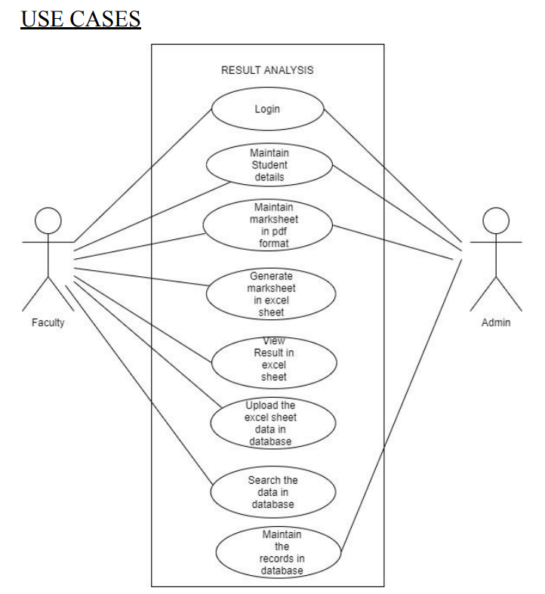
ANALYSIS & DESIGN

Slide 9
ANALYSIS & DESIGN
SOFTWARE REQUIREMENTS:
Operating systems: Windows
Software Used: MS Excel, Microsoft Visual Studio, Google Chrome
Programming Language: ASP.NET
HARDWARE REQUIREMENTS:
Intel Core i3 (Processor)
RAM: 4 GB
Hard Disk: 15 GB

Slide 10
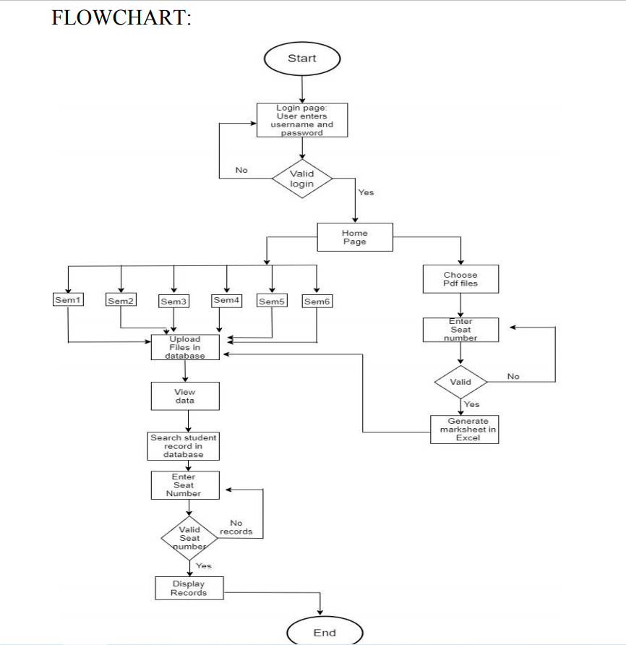
ANALYSIS & DESIGN

Slide 11
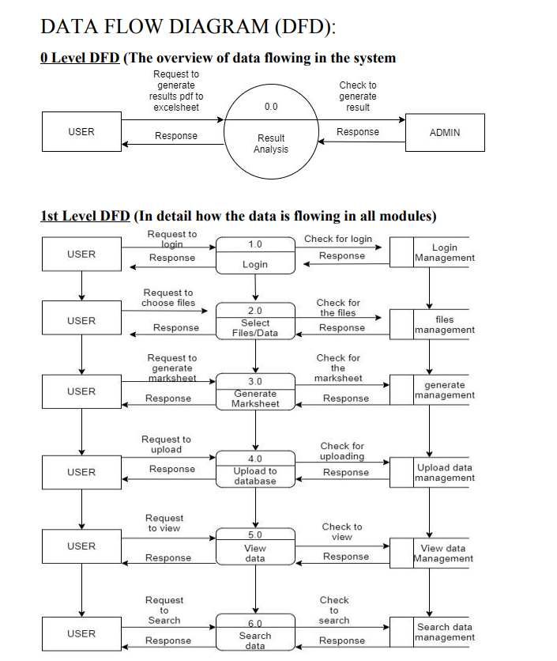
ANALYSIS & DESIGN

Slide 12
USER MANUAL
KEY FUNCTIONALITIES OF EACH MODULE:
A) Login module: For security purposes where without valid username and password no one can access this system.
B) Conversion pdf to excel: Where a user wants to convert the desired pdf marksheet to be converted into excel format.
C) Uploading Excel Sheet files in the database:Where a user can upload the converted file and upload it in the database for future reference.
D) Search a particular record from the database: When a user wants to search a particular record from the database it can search. by giving a valid input seat number and get the desired records of that student.

Slide 13
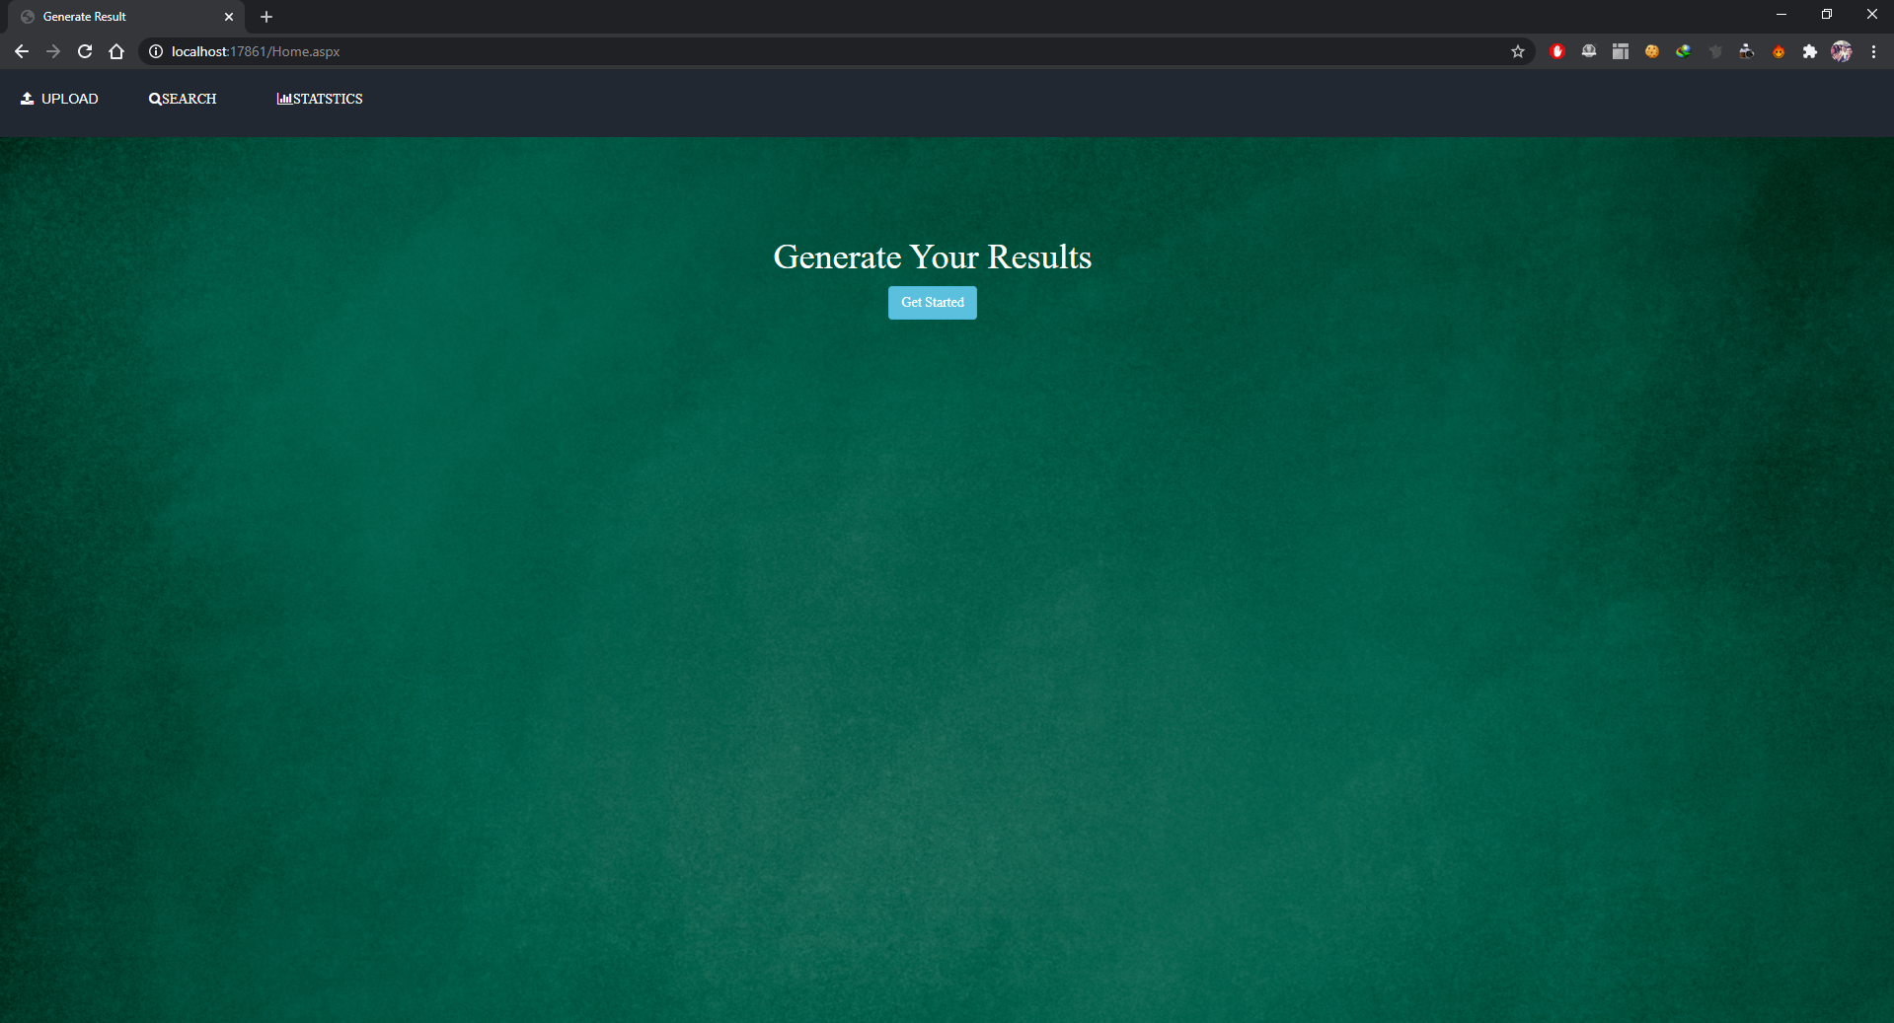
SCREENSHOTS
Figure: 1 Home Page

Slide 14
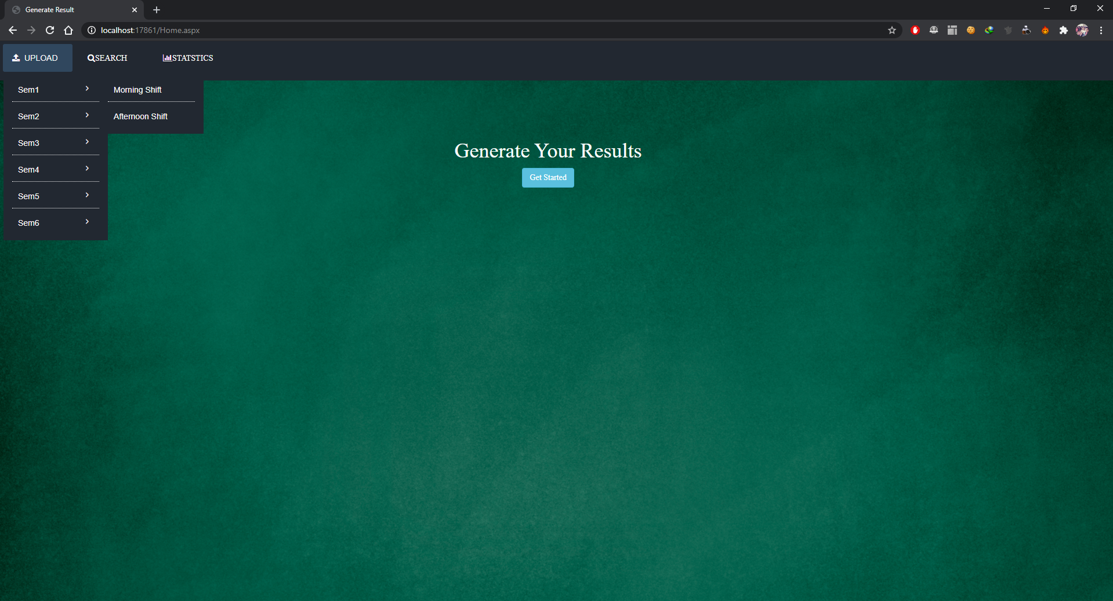
SCREENSHOTS
Figure: 1.1 Home Page

Slide 15
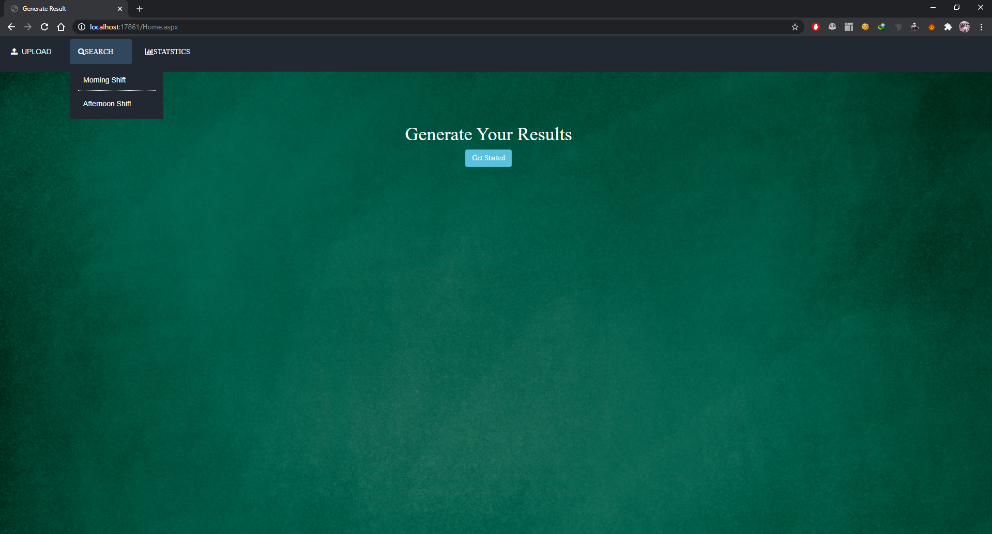
SCREENSHOTS
Figure: 1.2 Home Page

Slide 16
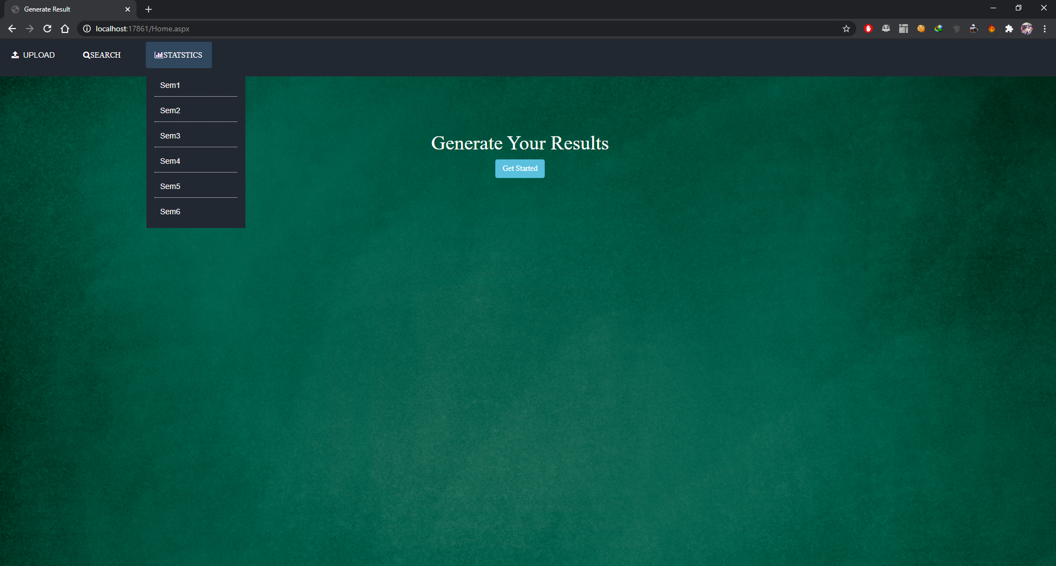
SCREENSHOTS
Figure: 1.3 Home Page

Slide 17
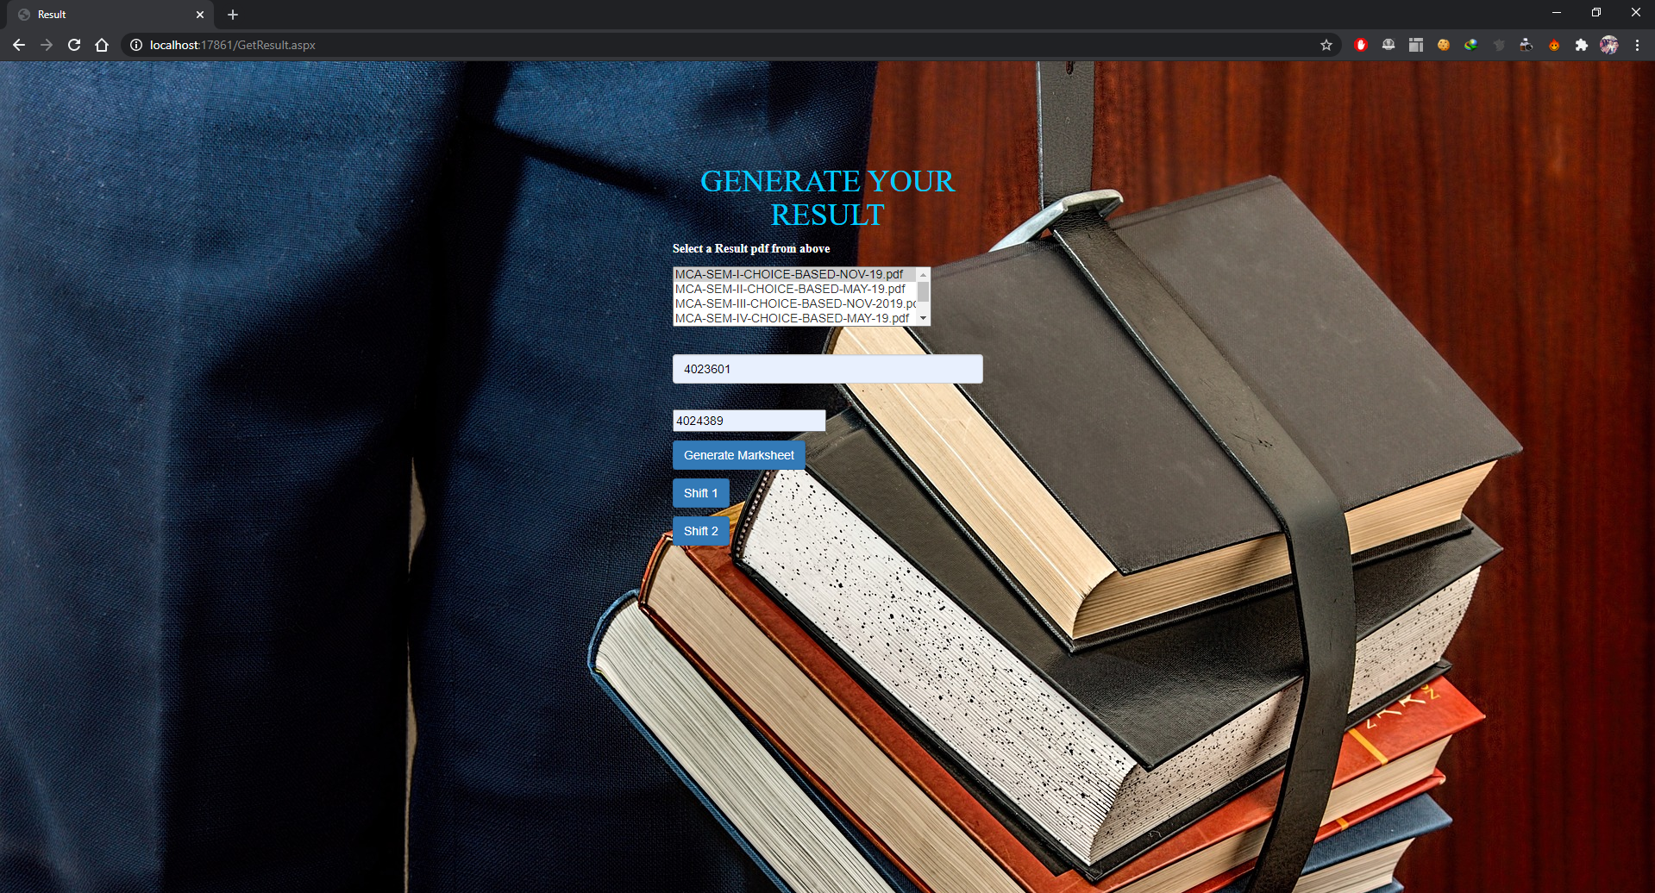
SCREENSHOTS
Figure:2 Generate Result Page

Slide 18
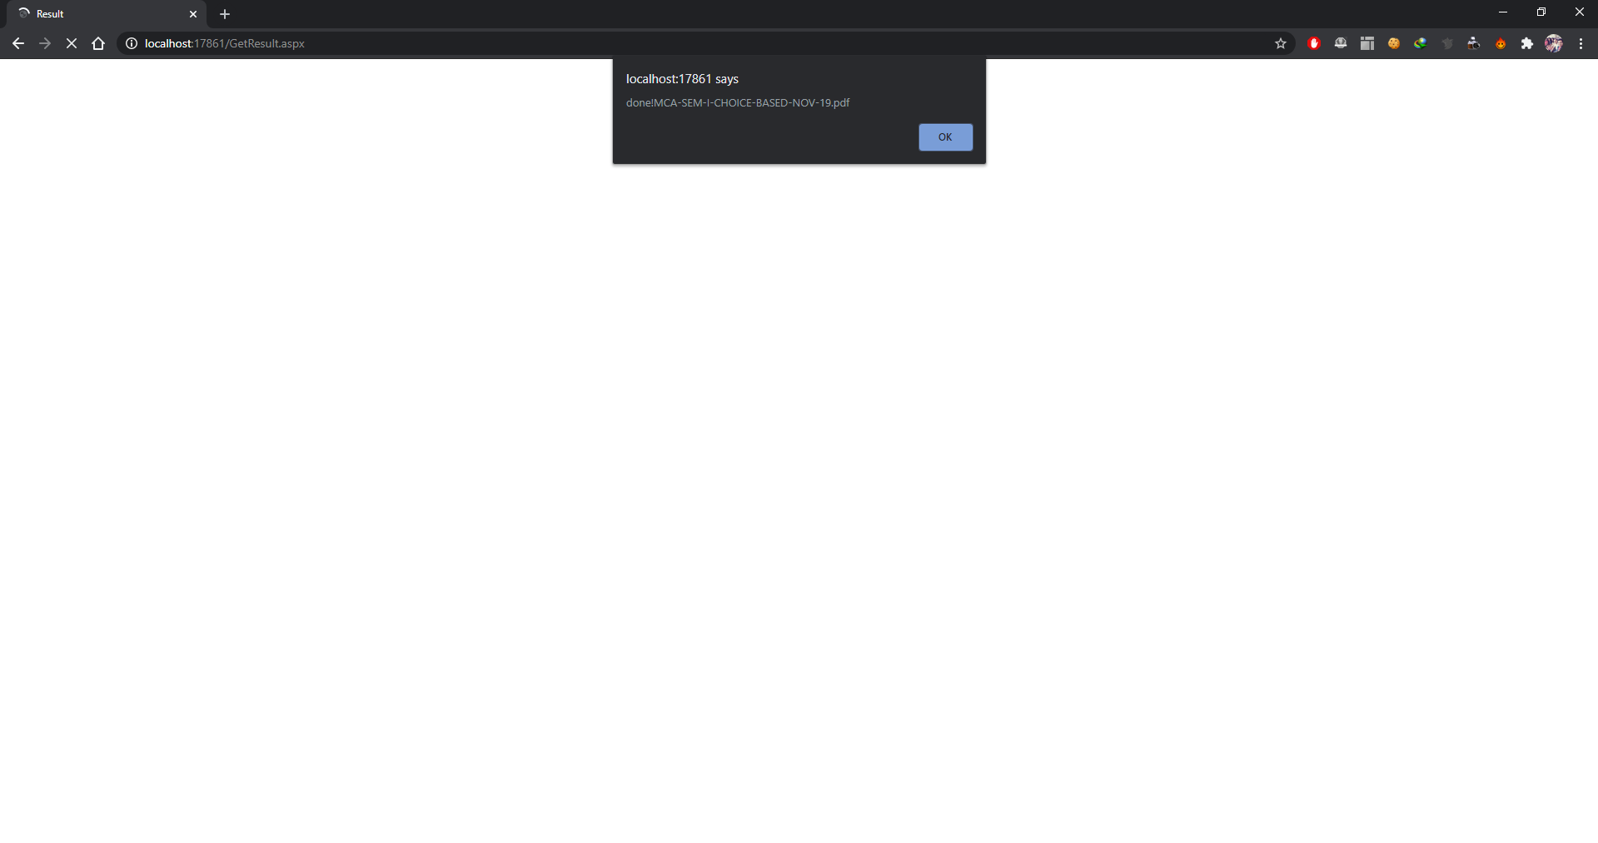
SCREENSHOTS
Figure:3 Converted pdf to excel sheet

Slide 19
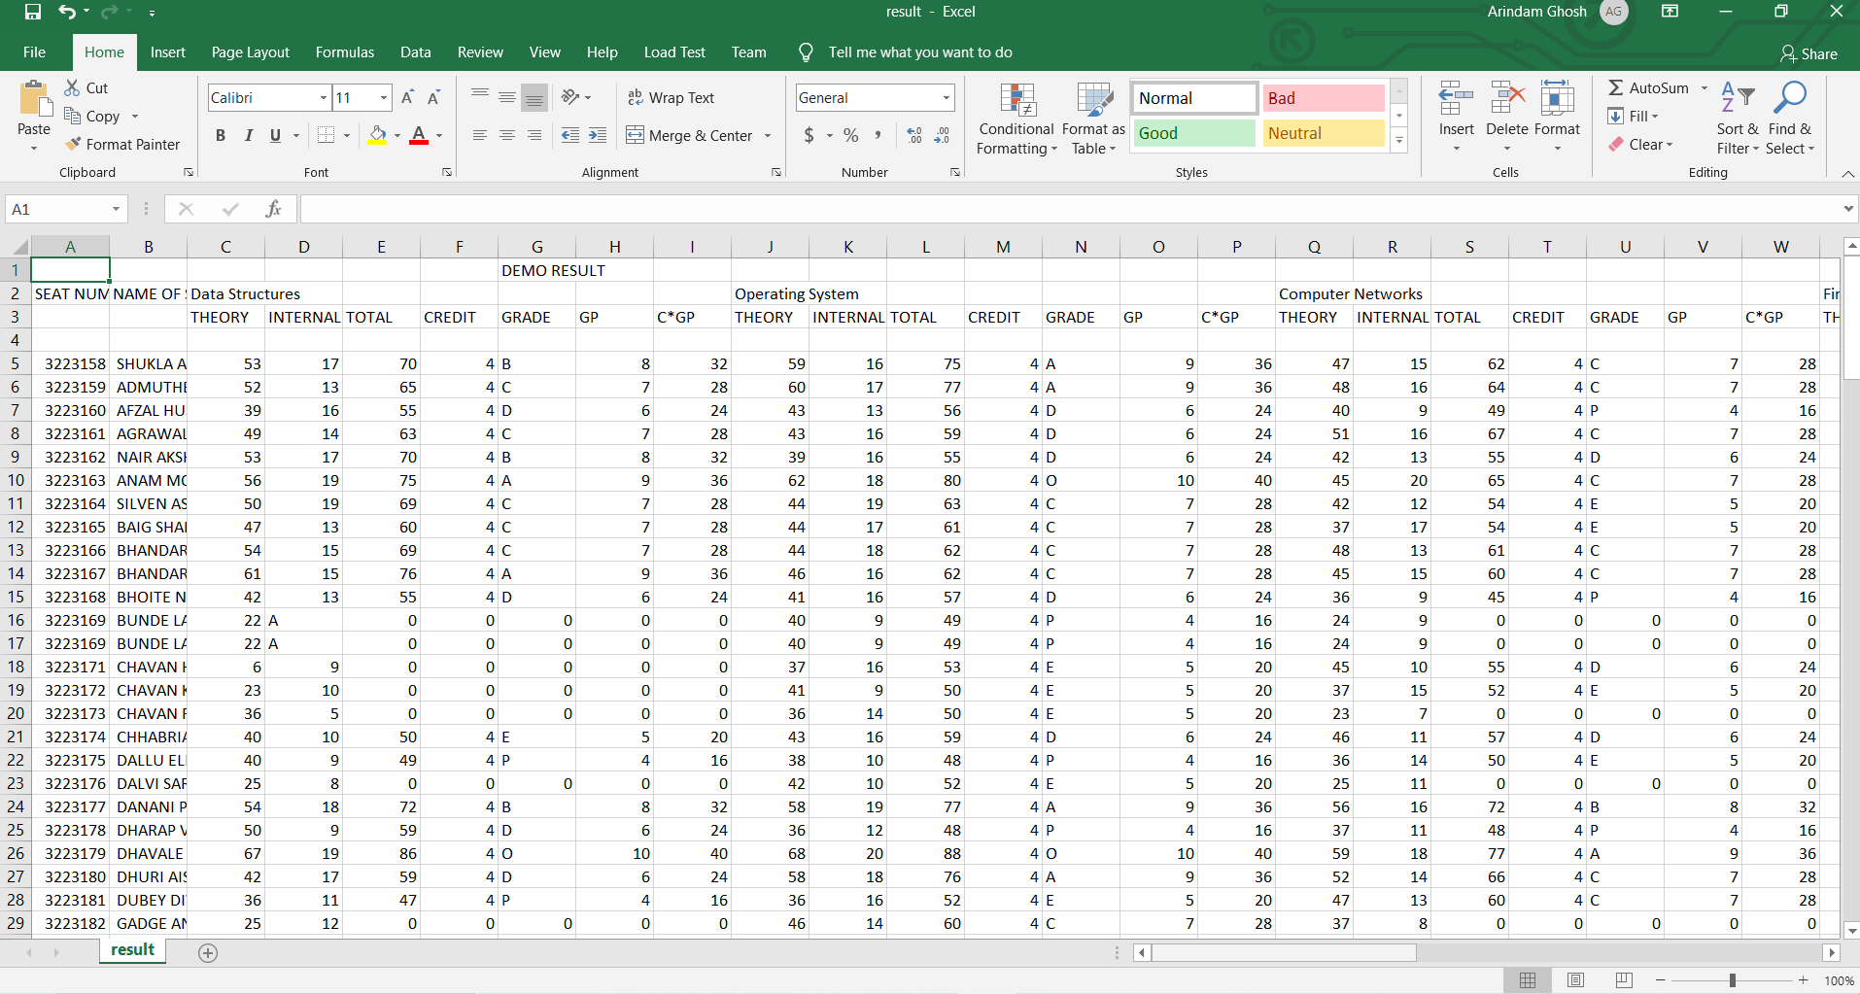
SCREENSHOTS
Figure:3.1 Converted pdf to excel sheet

Slide 20

SCREENSHOTS
Figure:4 Upload excel sheet data

Slide 21
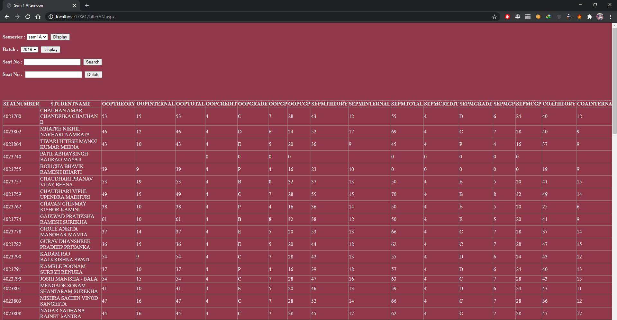
SCREENSHOTS
Figure:5 Display the student data page

Slide 22
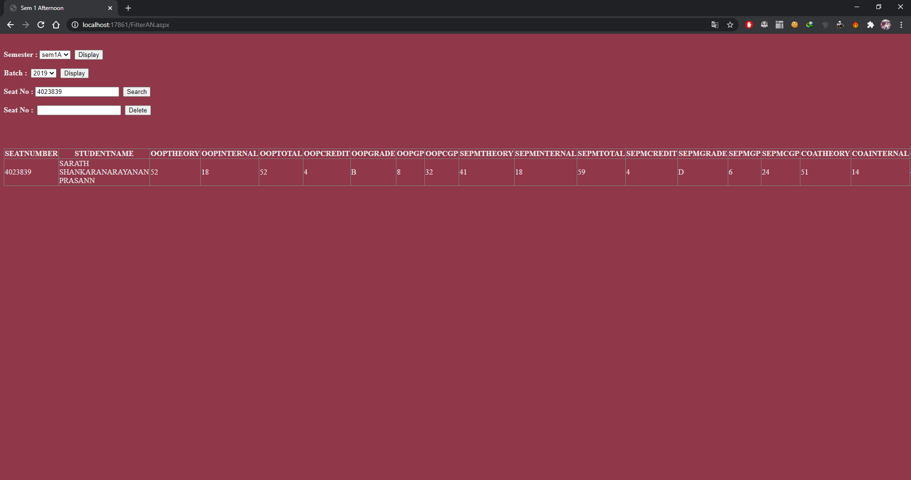
SCREENSHOTS
Figure:6 Search the student record page

Slide 23
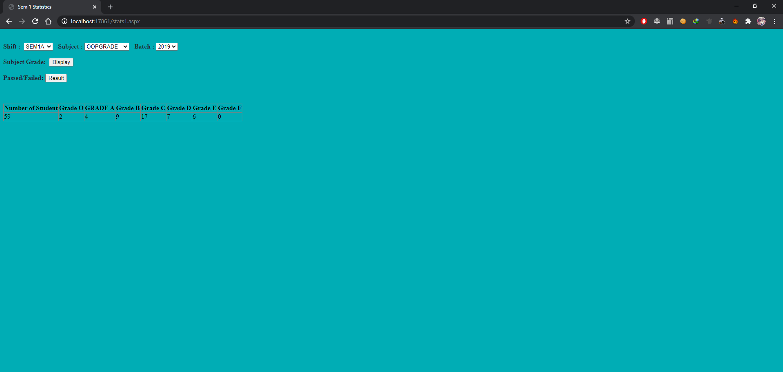
SCREENSHOTS
Figure:7 Overall Statistics of a particular shift

Slide 24
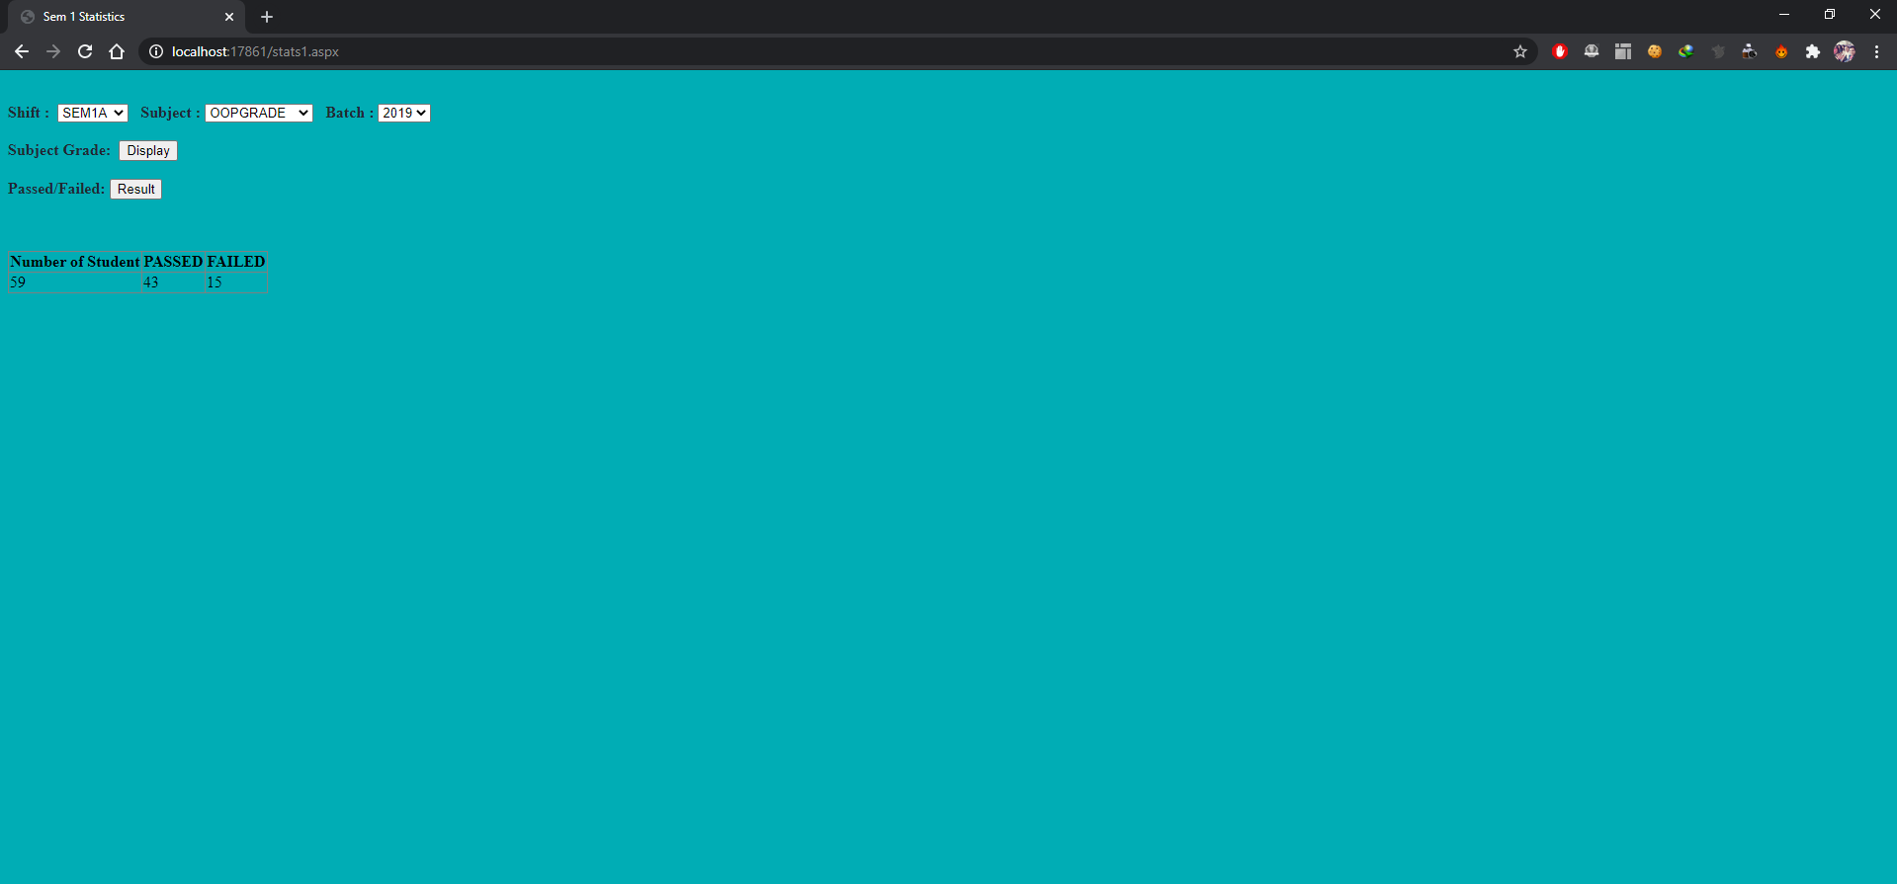
SCREENSHOTS
Figure:7.1 Overall Statistics of a particular shift passed or failed

Slide 25
CONCLUSION
FUTURE ENHANCEMENT:
There is a huge scope in this system where we can convert the mark sheet into other file formats along with excel sheet. Eg: Word, jpg and jpeg format.Where a user uploads the desired marksheet in the pdf form and it gets converted to the desired file format the user wants as per his requirement this will not only saves time of conversion but also work process will be smooth and efficient.

Slide 26
REFERENCES
BIBLIOGRAPHY:
● Programming ASP.NET Jesse Liberty
● ASP.NET Unleashed, Second Edition Stephen Walther
WEBLIOGRAPHY:
● https://www.tutorialspoint.com/
● https://www.guru99.com/

Slide 27


